Slide 1
Indoor localization from multiple RSSIs
Shimosaka Lab
Andy Chung

Slide 2
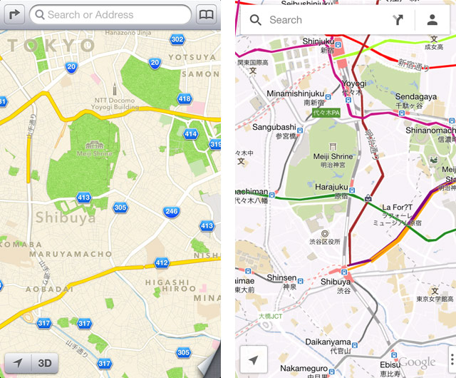
Google Maps

Slide 3
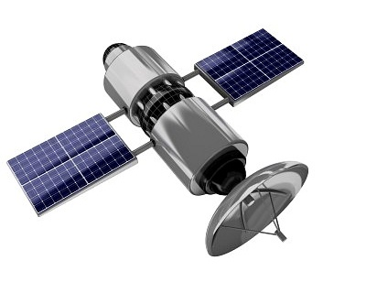

GPS

Slide 4
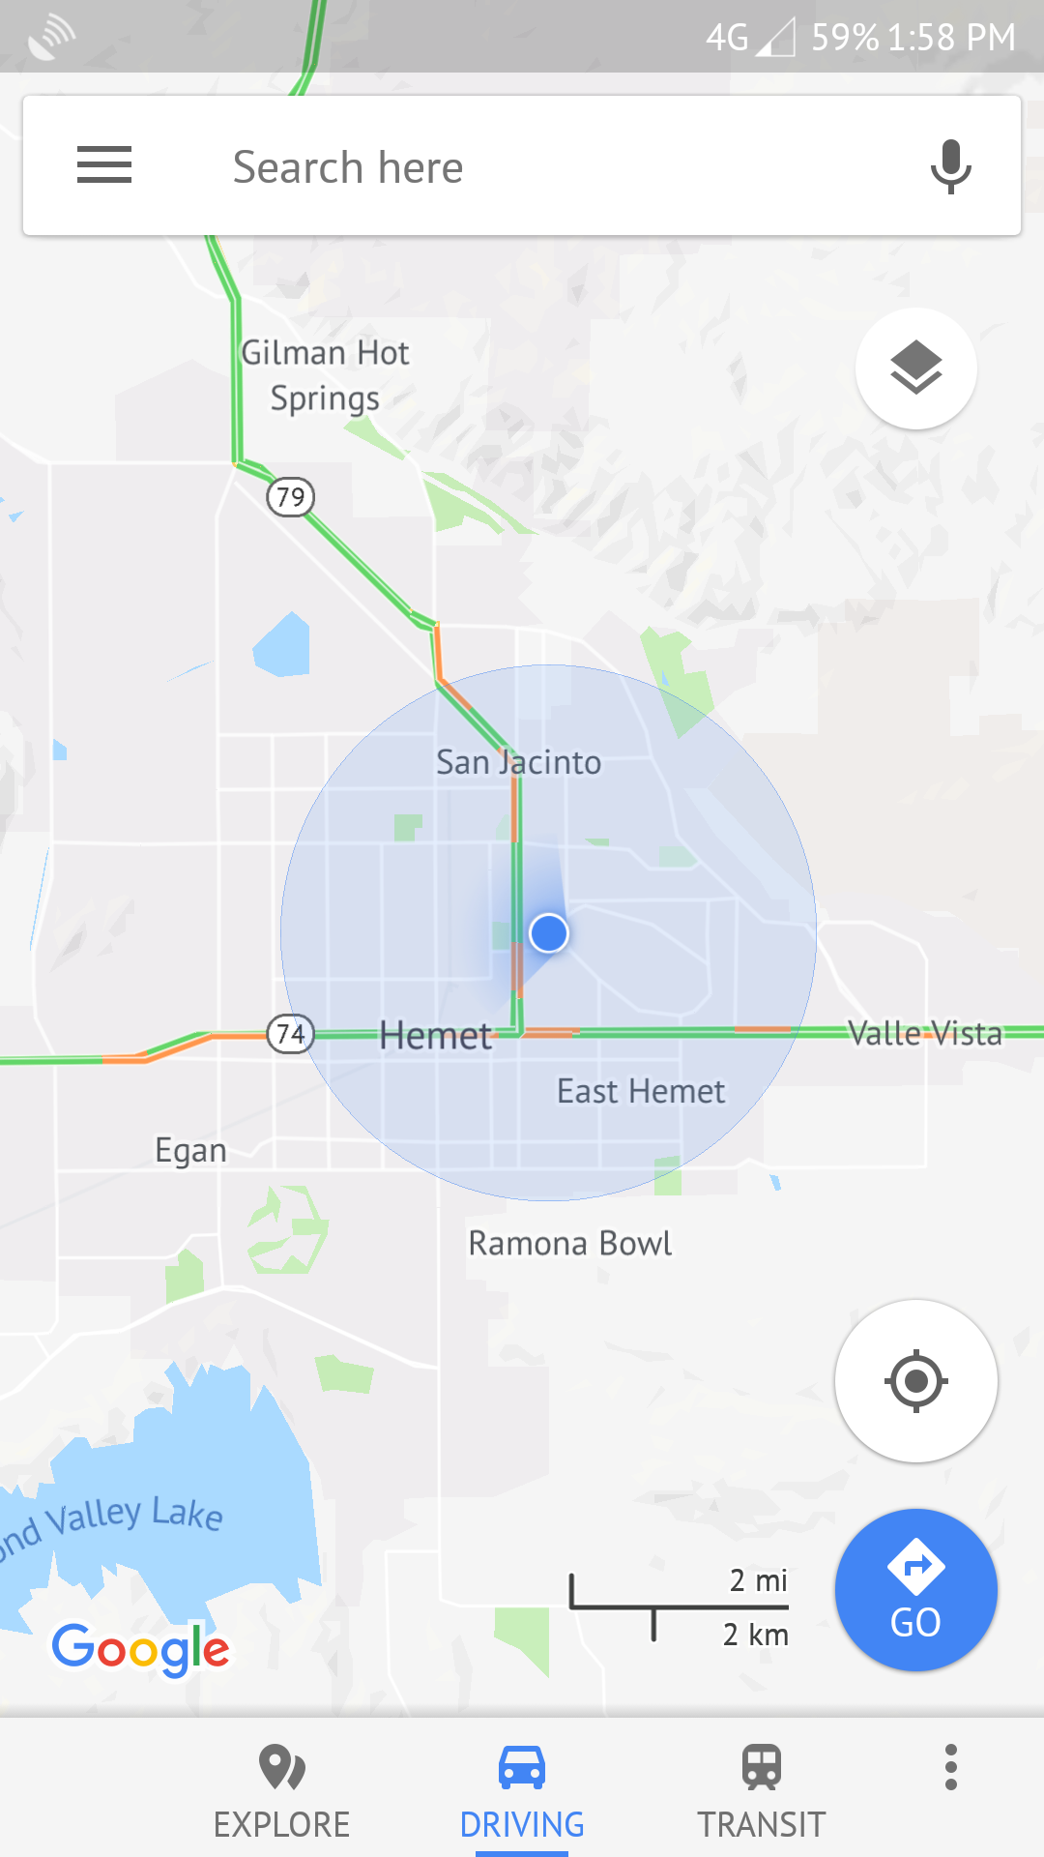
Problem

Slide 5
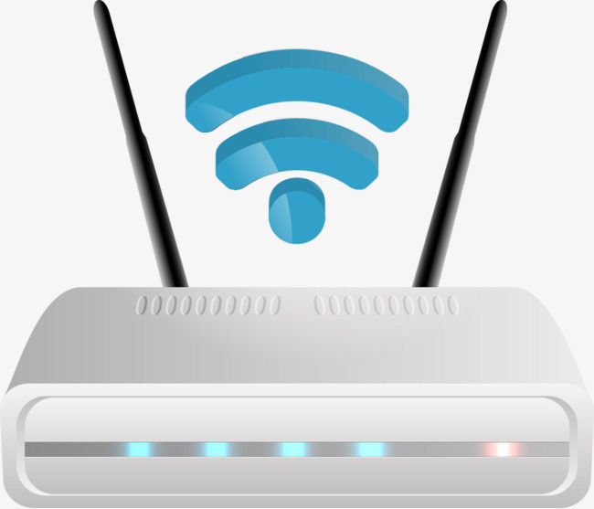
A solution

Slide 6
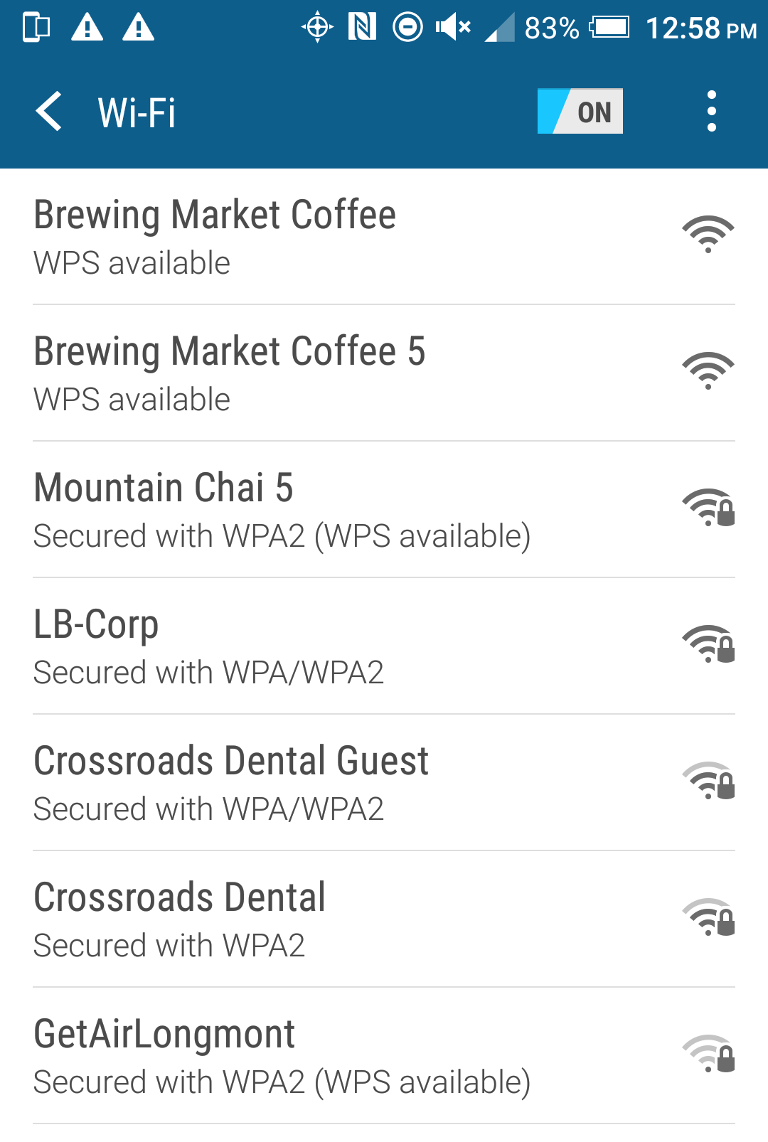
Received Signal Strength Indicator
(RSSI)

Slide 7
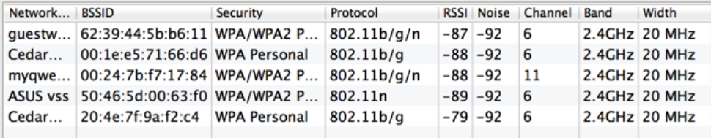
Data in table form

Slide 8
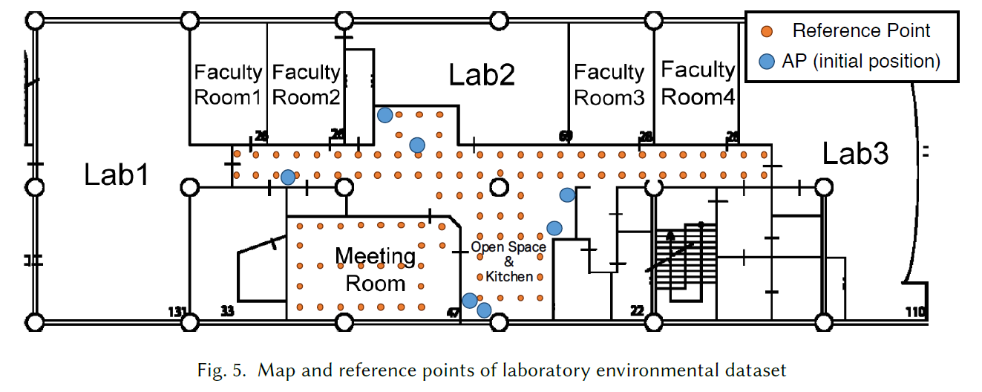
BSSID | RSSI
00:A0:C9:14:C8:29 | -69
00:25:96:FF:FE:12 | -37
00:1B:44:11:3A:B7 | -72
00:1b:63:84:45:e6 | -96
BSSID | RSSI
00:A0:C9:14:C8:29 | -69
00:25:96:FF:FE:12 | -37
00:1B:44:11:3A:B7 | -72
00:1b:63:84:45:e6 | -96
BSSID | RSSI
00:A0:C9:14:C8:29 | -69
00:25:96:FF:FE:12 | -37
00:1B:44:11:3A:B7 | -72
00:1b:63:84:45:e6 | -96
How does it work?
BSSID | RSSI
00:A0:C9:14:C8:29 | -69
00:25:96:FF:FE:12 | -37
00:1B:44:11:3A:B7 | -72
00:1b:63:84:45:e6 | -96
BSSID | RSSI
00:A0:C9:14:C8:29 | -69
00:25:96:FF:FE:12 | -37
00:1B:44:11:3A:B7 | -72
00:1b:63:84:45:e6 | -96
BSSID | RSSI
00:A0:C9:14:C8:29 | -69
00:25:96:FF:FE:12 | -37
00:1B:44:11:3A:B7 | -72
00:1b:63:84:45:e6 | -96
Dataset
First collect data

Slide 9
MarkerID | Latitude | Longitude
3142 | 39.185734 | 159.98372
MarkerID | Latitude | Longitude
3142 | 39.185734 | 159.98372
MarkerID | Latitude | Longitude
3142 | 39.185734 | 159.98372
Dataset
MarkerID | Latitude | Longitude
3142 | 39.185734 | 159.98372
MarkerID | Latitude | Longitude
3142 | 39.185734 | 159.98372

Slide 10

k-nearest neighbors algorithm
BSSID | RSSI
00:A0:C9:14:C8:29 | -75
00:25:96:FF:FE:12 | -25
00:1B:44:11:3A:B7 | -63
00:1b:63:84:45:e6 | -94
Data collected from current location
BSSID | RSSI
00:A0:C9:14:C8:29 | -69
00:25:96:FF:FE:12 | -37
00:1B:44:11:3A:B7 | -72
00:1b:63:84:45:e6 | -96
BSSID | RSSI
00:A0:C9:14:C8:29 | -69
00:25:96:FF:FE:12 | -37
00:1B:44:11:3A:B7 | -72
00:1b:63:84:45:e6 | -96
BSSID | RSSI
00:A0:C9:14:C8:29 | -69
00:25:96:FF:FE:12 | -37
00:1B:44:11:3A:B7 | -72
00:1b:63:84:45:e6 | -96
BSSID | RSSI
00:A0:C9:14:C8:29 | -69
00:25:96:FF:FE:12 | -37
00:1B:44:11:3A:B7 | -72
00:1b:63:84:45:e6 | -96
BSSID | RSSI
00:A0:C9:14:C8:29 | -69
00:25:96:FF:FE:12 | -37
00:1B:44:11:3A:B7 | -72
00:1b:63:84:45:e6 | -96
Dataset
(Collected beforehand)

Slide 11
k-nearest neighbors
MarkerID | ||RSSI1 – RSSI2||
3125 | 16
4125 | 3
3213 | 33
5831 | 42
MarkerID | ||RSSI1 – RSSI2||
4125 | 3
3125 | 16
3213 | 33
5831 | 42
Sort

Slide 12
MarkerID | Latitude | Longitude
4125 | 39.185734 | 159.98372

Slide 13


Server Architecture

Slide 14
Server side
Create converter based on currently visible BSSIDs
Load dataset from fs
iterate through all .csv files
Make featureVector that consists of every fingerprint from the dataset
var dataSet = Map[markerID, ArrayBuffer[Fingerprint]]

Slide 15
RESTful API
Client
Collect fingerprint data using terminal airport command
Send Fingerprint data as a post request in JSON format
Server
Receives post request
val inputVector = converter.convertToVec(input)
norm(featureVector - inputVector)
var distances: ArrayBuffer[(markerID, norm)]
val closestMarker = distances.minBy
BSSID | RSSI
00:A0:C9:14:C8:29 | -75
00:25:96:FF:FE:12 | -25
00:1B:44:11:3A:B7 | -63
00:1b:63:84:45:e6 | -94

Slide 16
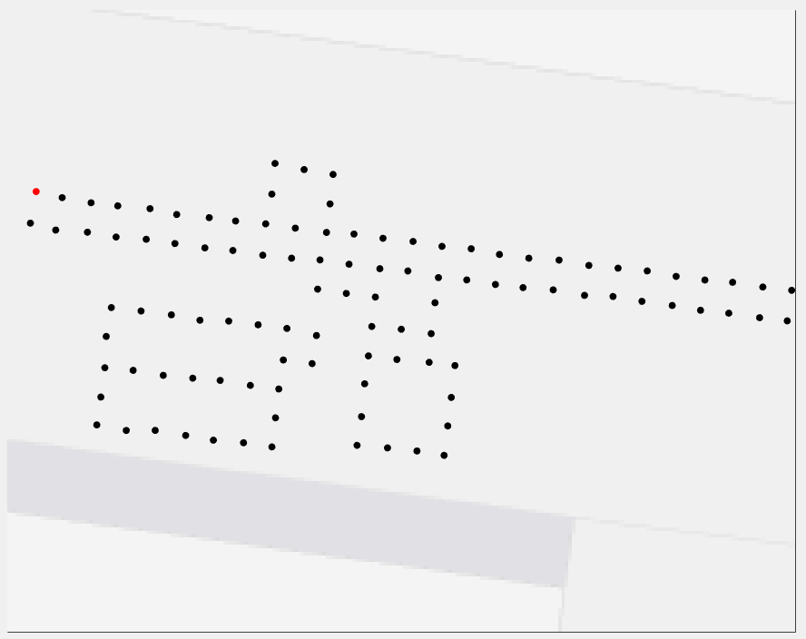
RESTful API
Client
Server
Response(Latitude,Longitude)

Slide 17
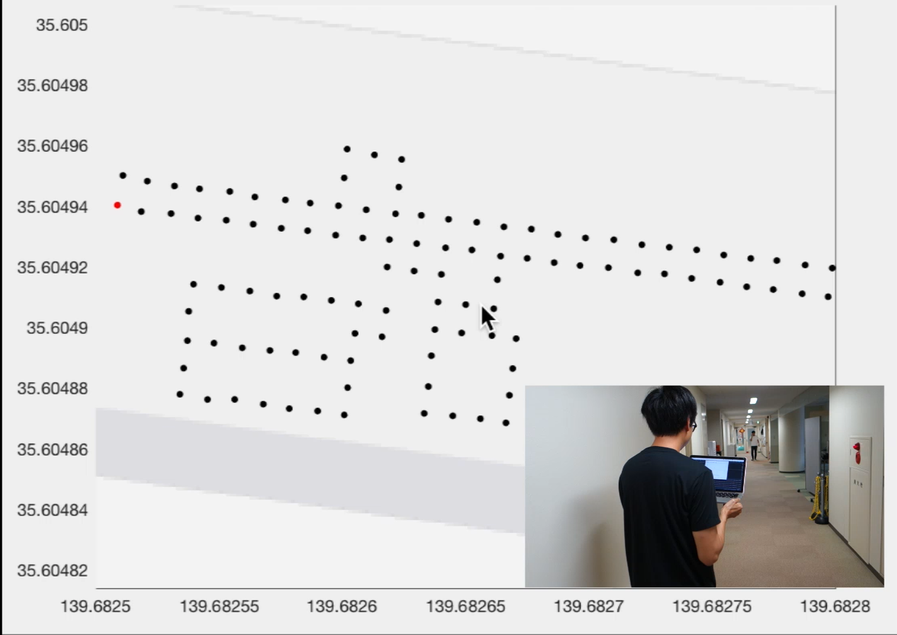
Demo

Slide 18
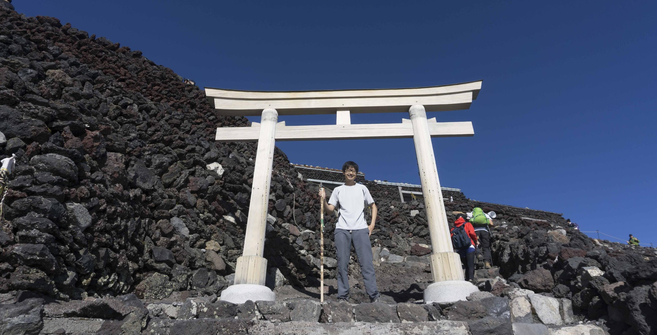

Slide 19
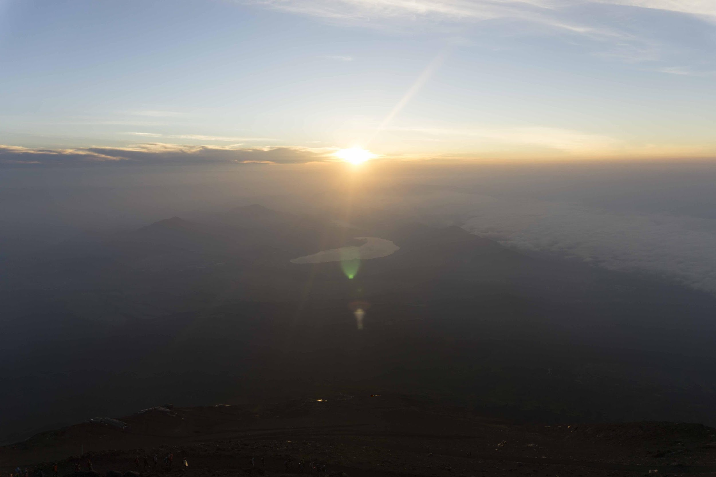

Slide 20
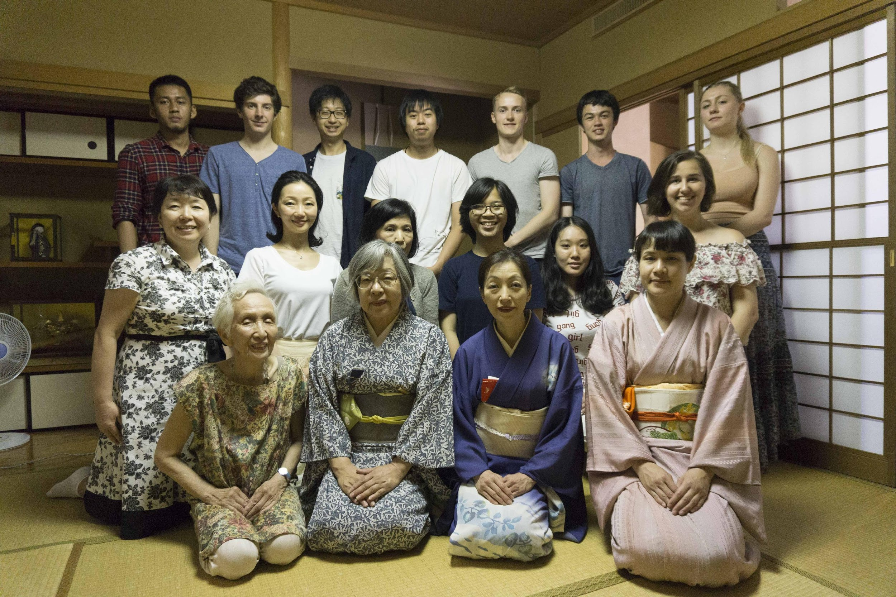

Slide 21

Follow me on Instagram
@_andy_chung

